Slide 1


vikas
Notes:
Automation with Ansible Playbook
sudo vi /etc/hostname -- > edit hostname
sudo vi /etc/hosts -- > localhost <name you want >

Slide 2
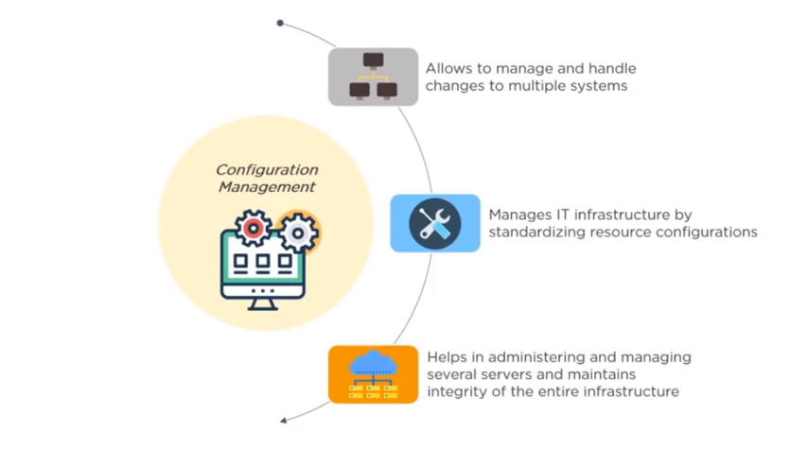
Notes:
Consider a system admin who is managing 100 of Linux servers .
So, post configuration part after server build ,software patching ,application deployment are done regularly and manually .
Let’s assume there is a vulnerability related to SSH & you have to figure out what is the version on each server .
Log to each server – Manually
Automate the configuration.

Slide 3
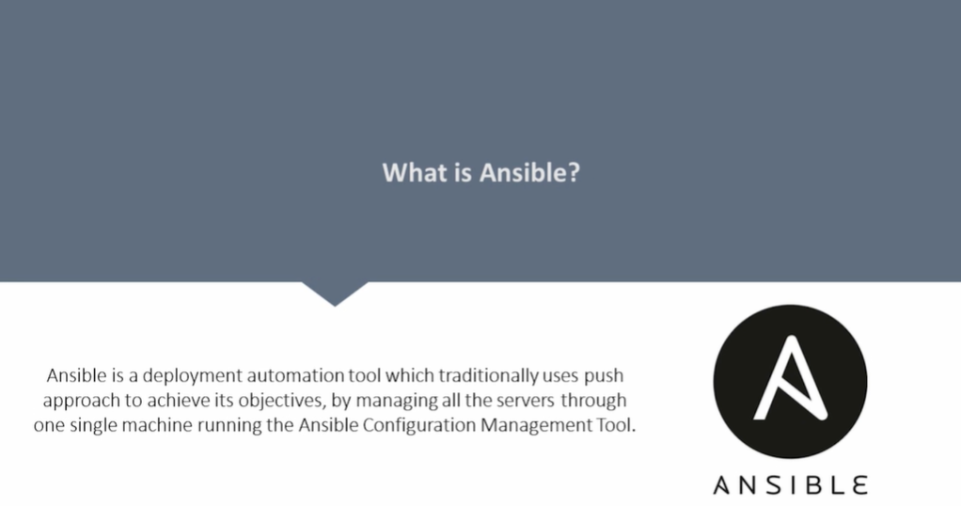
Notes:
Ansible is a simple IT automation platform that makes your applications and systems easier to deploy.
Ansible is an open-source software provisioning, configuration management, and application-deployment tool.
It runs on many Unix-like systems and can configure both Unix-like systems as well as Microsoft Windows.
It includes its own declarative language to describe system configuration .
Ansible was originally written by Michael DeHaan . Ansible has been widely adopted, because it is simple to use for system administrators. Developers ease into using Ansible because it is built on Python.
Ansible is included as part of the Fedora distribution of Linux, owned by Red Hat, and is also available for Red Hat Enterprise Linux, CentOS, Debian, Scientific Linux, Oracle Linux via Extra Packages for Enterprise Linux (EPEL).
http://docs.ansible.com/
http://docs.ansible.com/ansible/latest/intro_installation.html
Osboxes.com
https://docs.ansible.com/ansible/latest/installation_guide/intro_installation.html

Slide 4
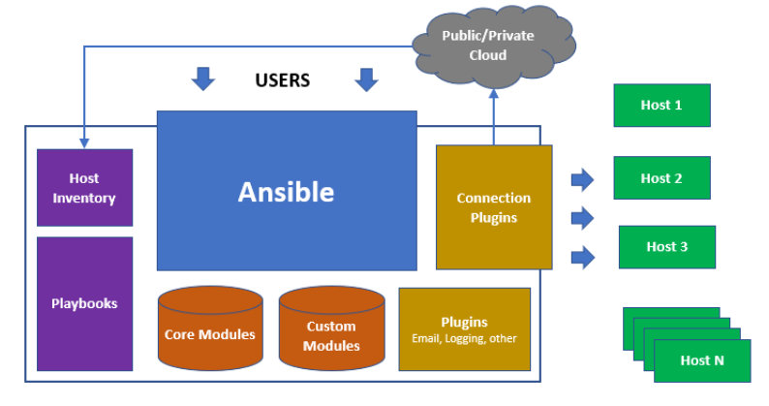
Notes:
Ansible playbooks – An organized unit of scripts which defines work of server configuration and written in YAML .Instead of writing custom, individualized scripts, system administrators create high-level plays in Ansible. A play performs a series of tasks on the host, or group of hosts, specified in the play. A file that contains one or more plays is called a playbook.
A managed host is a system that Ansible logs into, installs modules, and executes remote commands to perform configuration tasks. Other names for a managed host include managed node and remote node.
Ansible uses SSH to communicate with managed hosts, so SSH must be installed and configured to allow incoming connections. Managed hosts must have Python 2.4 or later installed to run Ansible, which includes Red Hat Enterprise Linux 5, 6, and 7 hosts.
The python-simple json package must also be installed on Red Hat Enterprise Linux 5 managed hosts. It is not required on Red Hat Enterprise Linux 6 and 7 managed hosts, since Python 2.5 (and newer versions) provide its functionality by default.
Host Inventory defines which hosts Ansible manages. Hosts may belong to groups which are typically used to identify the hosts' role in the datacenter. A host can be a member of more than one group.
Limitations :
Ansible can add packages to an installation, but it does not perform the initial installation of the system. Every system can start with a minimal installation, either via Kickstart or a base cloud starter image, then use Ansible for further configuration.
Although Ansible can remediate configuration drift, it does not monitor for it.
Ansible does not track what changes are made to files on the system, nor does it track what user or process made those changes.

Slide 5
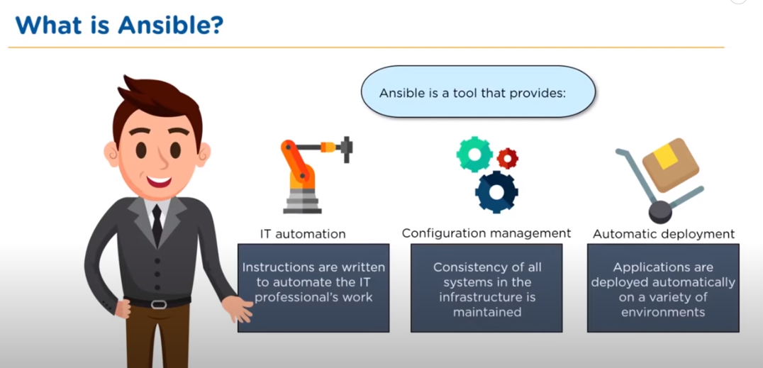
Notes:
Ansible can help you with provisioning and configuration management, application deployment & task automation as shown below:
Configuration of servers – like installing a particular application on 100 machines .Just write the playbook and automate the stuff .
Application deployment – Number of steps to be followed to deploy an application.
Continuous testing of already install application
Provisioning – Bare metal installation .
Orchestration – Like first remove the ALB then update the server .
Automation of tasks
It’s agentless (you don’t have to install anything on the host) Just SSH from Master . So, no server management activity .
Large number of ready to use modules for system management & Custom modules can be added if needed.
Configuration roll-back in case of error .Implement Sudo passwd, so that normal needs password to elevate his privilege.
Implementation of Infrastructure
Deployment of application when environment changes .
Compatible with any platform
Secure and scalable

Slide 6
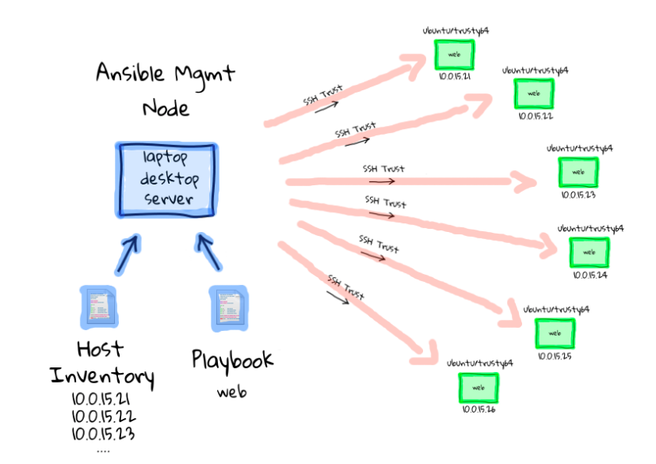
Notes:
System administrators log in and initiate all Ansible operations from the control node. Ansible software is installed on the control node. Ansible configuration files are also maintained on the control node.
A machine acting as a control node must have Python 2.6 or 2.7 installed. This includes Linux, OS/X, and any BSD based Unix system. Windows is not supported for the control node at this time.
Ansible Engine/ Controller / Master -- -- > SSH -- > Ansible Nodes/ Clients

Slide 7
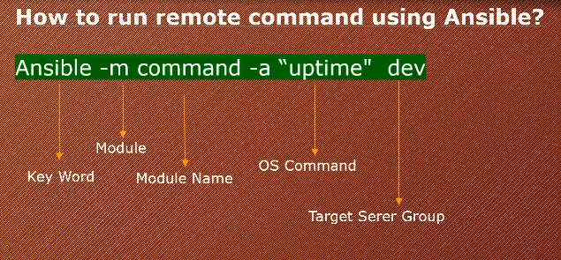
Notes:
List Machines under one subgroup in hosts(inventory) file :
default location : /etc/ansible/hosts
ansible-doc -l
ansible --list-hosts <subgroup name>
ansible group1:group2 -m shell -a “uptime”
ansible –m command –a “uptime” <subgroup name>
ansible –m command –a “uname –a ” <subgroup name>
ansible –m ping <subgroup name>
ansible –m file –a “dest=/tmp/abc mode=777 owner=john group=admin” <subgroup name>
ansible –m file –a “dest=/tmp/abc mode=777 owner=john group=admin” <subgroup name> --become --become-method=sudo --become-user=root –K
ansible –m file –a “dest=/tmp/hosts_testing state=absent” --become –K <subgroup name>
ansible –m file –a ‘content=“Managed by ansible\n” dest=/tmp/practice’
If You want to avoid these options
edit cat /etc/ansible/ansible.cfg the previledge as root user
ansible –m command –a “hostname” <subgroup name>
[webservers]
localhost ansible_connection=local
web1.example.com
web2.example.com:1234 ansible_connection=ssh ansible_user=ftaylor
172.68.23.[0:100]
To give root privilege – visudo -- <username> ALL= (ALL) NOPASSWD: ALL
To give root privilege – visudo -- <username> ALL= (ALL) PASSWD: ALL
ansible –m command –a “uptime” <subgroup name> --become –k
Provide password
ansible –m copy –a “src=/etc/hosts dest=/tmp/hosts” <subgroup name>
ansible –m command –a “set” <subgroup name>
ansible –m shell –a “set” <subgroup name>
dmidecode command is used when the user want to retrieve system's hardware related information such as Processor, RAM(DIMMs), BIOS detail, Memory, Serial numbers etc. ...
vgs command provides volume group information in a configurable form, displaying one line per volume group.
cd etc/ansible
ansible <group-name> -m ping
ansible agent1 –m command –a “ apt install apache2”
ansible <group> -m <module>
ansible apache -m ping
---------------------Ad hoc Commands---------------------------------
ansible all -m command -a 'ls'
ansible all -m command -a 'pwd'
ansible agent1 -m file -a 'path=/root/test.txt state=touch mode=0770 owner=root'
ansible agent1 -m file -a 'path=/root/test state=directory mode=0770 owner=root'
ansible-doc -l
ansible-doc <module-name>
ansible agent -m setup -u root
-----------------------Install Apache----------------------------------
ansible agent1 -m command -a "apt update"
ansible agent1 -m command -a "apt upgrade"
ansible agent1 -m command -a "apt install apache2"
ansible agent1 -m service -a "name=apache2 state=started"
ansible agent1 -m command -a "apt -y remove apache2"

Slide 8
Customizing Ansible behavior
The behavior of an Ansible installation can be customized by modifying settings housed in
ansible's configuration file (/etc/ansible/ansible.cfg).
privilege_escalation section in the ansible.cfg configuration file by adding the following entry.
[privilege_escalation]
Enable privilege escalation by adding the become setting and configuring it as True.
become=True
Set the privilege escalation to use sudo by adding the become_method setting and configuring it as sudo.
become_method=sudo
Set the privilege escalation user by adding the become_user setting and configuring it as root.
become_user=root
Enable password prompting during privilege escalation by adding the become_ask_pass setting and configuring it as True.
become_ask_pass=True
Notes:
To do activity like server patching we need to elevate our privilege as root user:
cat /etc/ansible/ansible.cfg
host_key_checking = False
ANSIBLE_KEEP_REMOTE_FILES=1 ansible all -m shell -a “uptime” – This command will keep all the temp script push from main ansible controller to host servers .
Copy Command :
ansible all -m copy -a “src=./hosts dest=/tmp/inventory”
ansible all -m copy -a “content=‘My New File’ dest=/tmp/hello.txt”
ansible all -m copy -a “content=‘My New File’ dest=/tmp/hello.txt backup=yes”
Fetch Command “
ansible all -m fetch -a “src=./hosts/demo.txt dest=/tmp/{{inventory_hostaname}}_demo.txt flat=yes” will copy from source to destination without the folder structure
Create a file :
ansible all -m file -a “path=/tmp/demo.txt state=touch mode=‘0777’” will create a new file with specified values
ansible all -m file -a “path=/tmp/demo.txt state=absent” will delete the new files
Create a directory :
ansible all -m file -a “path=/tmp/hello state=directory” will create a new directory

Slide 9
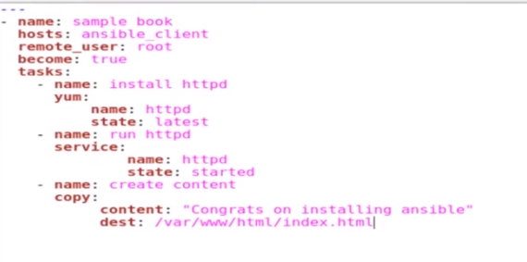

Slide 10
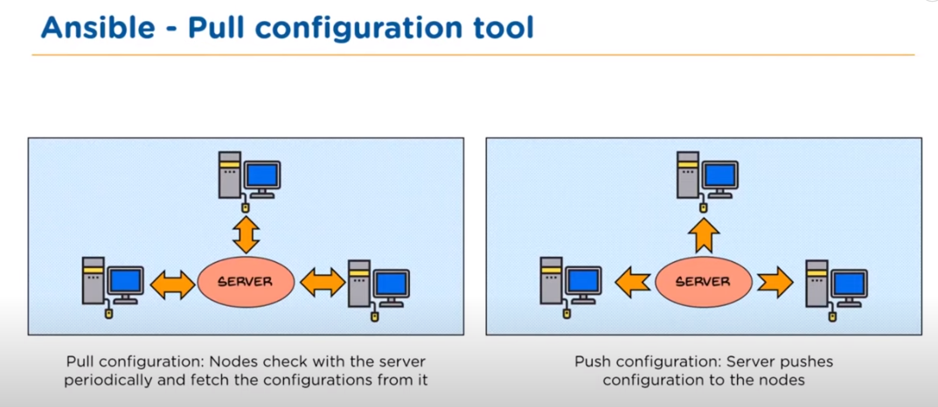

Slide 11
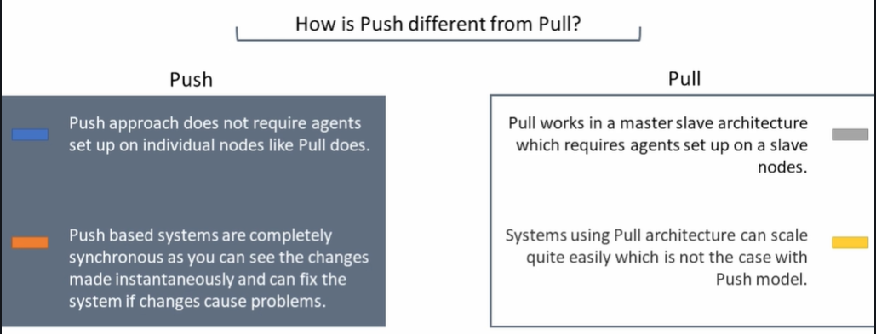
Notes:
Infrastructure upgradation is required then pull methodology is better.

Slide 12
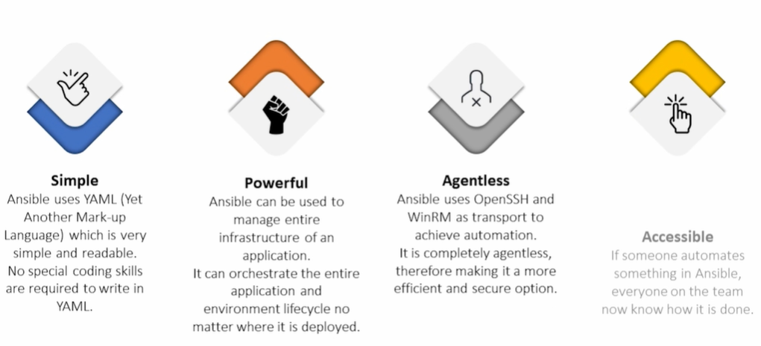
Notes:
vim /etc/sudousers
change inside -- > user1 ALL=NOPASSWD: ALL -- > Save and exit
systemctl restart sshd
On Server :
-----------
ansible <webserver> -m user –a “name=John password=john” –s
ansible <webserver> -m service –a “name=httpd state=started” –s

Slide 13
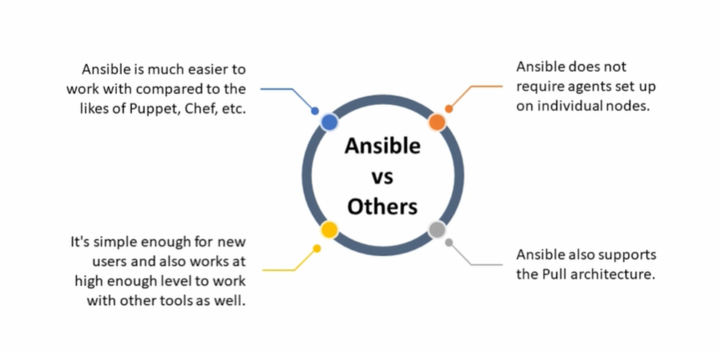

Slide 14
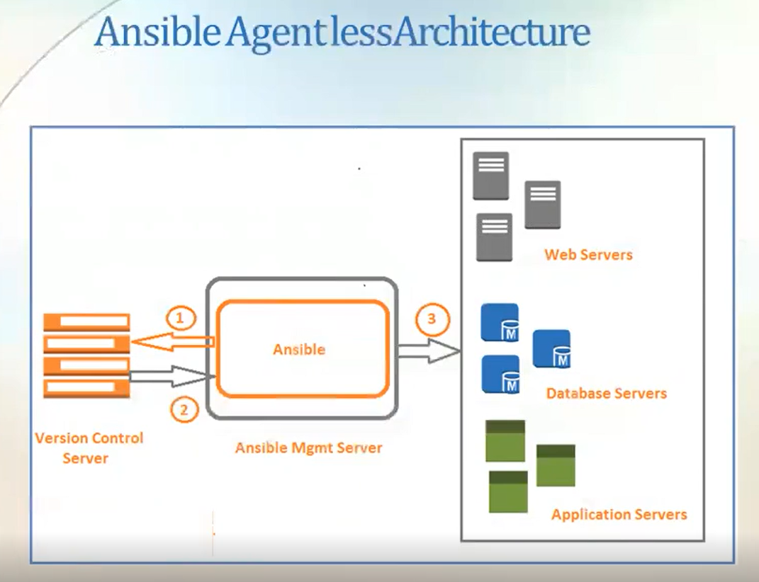

Slide 15
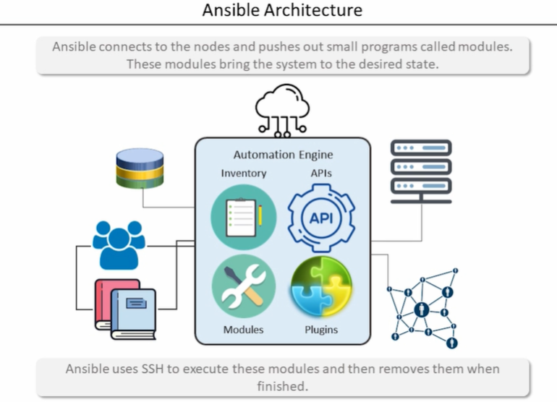
Notes:
Users can group the machine with there likings
ansible -m command -a “uptime” <ip>
ansible-doc –l
ansible-doc ping
ansible <group name > -m user –a “name=john password=john” –s
ansible <group name > -m services –a “name=httpd status=started” –s
ansible <group name > -m copy –a “src=<src path> dest=<dest path>” –s

Slide 16
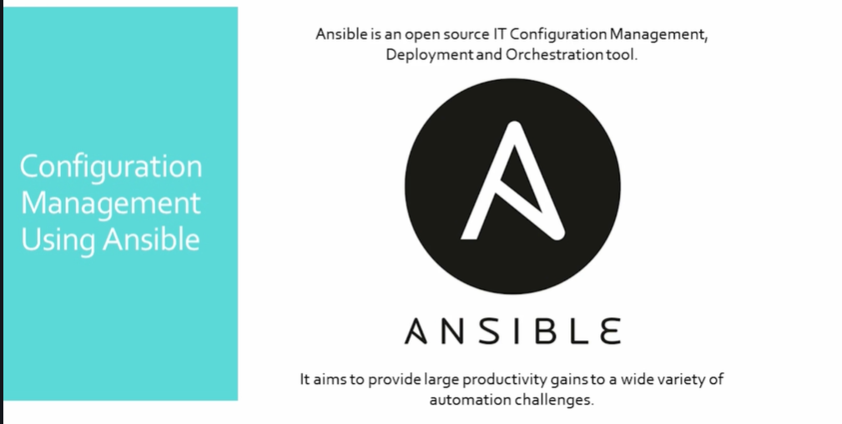
Notes:
---
- hosts: all
become: true
tasks:
- name: Install Nginix package
yum: name=nginx state=present
ignore_errors: yes
ansible-playbook playbook1.yml --list-hosts
ansible-playbook playbook1.yml --syntax-check
ansible-playbook playbook1.yml
---
- hosts: all
become: true
tasks:
- name: Transfer script files
copy: src= /tmp/test.sh dest=/tmp/
ignore_errors: yes
- name: Execute script files
command: sh test.sh
ignore_errors: yes
---
- hosts: all
become: true
tasks:
- name: Install Tomcat package
yum: name=tomcat state=latest
- name: Start Tomcat service
service: name=tomcat state=started
- name: Deploy war file to Tomcat server
copy: src=sample.war dest=/usr/share/tomcat/webapp
ignore_errors: yes
notify: restart tomcat
handlers:
- name: restart tomcat
service: name=tomcat state=restarted
---
- hosts: all
become: true
become_user: root
vars:
src_path: /etc/ansible
dest_path: /var/www/html
tasks:
- name: Install httpd package
yum: name=httpd state=present
- name: start httpd service
service: name=httpd state=started
- name: Deploy war file to Tomcat server
copy: src={{src_path}}/index.html dest={{dest_path}}
ignore_errors: yes
notify: restart httpd
handlers:
- name: restart httpd
service: name=tomcat state=restarted

Slide 17
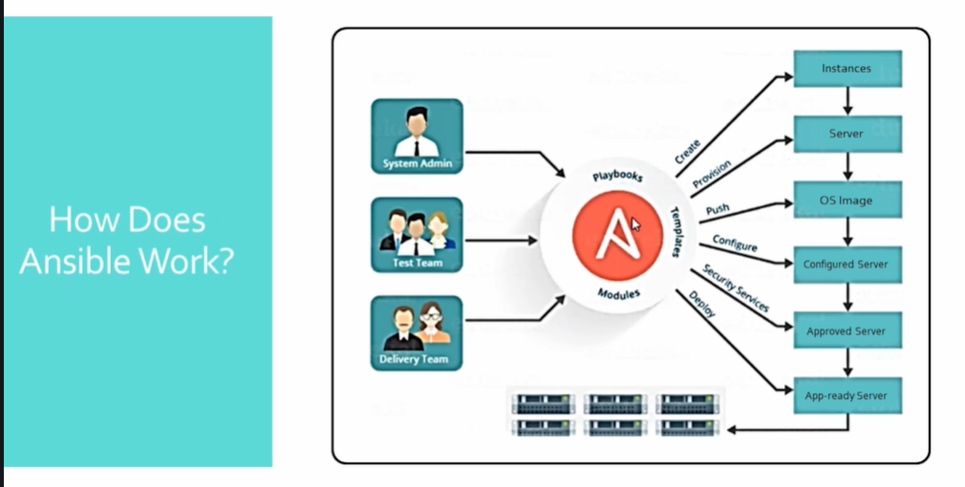
Notes:
Roles are instant rules available on Ansible galaxy .
Playbooks can be transformed into roles which are more effective and reusable.
mkdir files handlers meta tasks vars
sudo ansible-galaxy install --roles-path /etc/ansible/roles geerlingguy

Slide 18
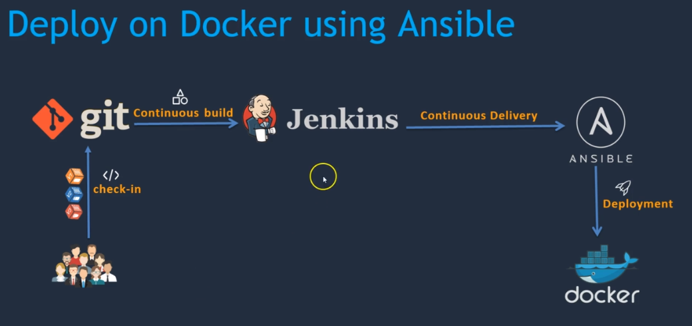
Notes:
yum install python python-pip –y
pip install ansible or sudo amazon-linux-extras install ansible2
ansible --version
python --version
mkdir /etc/ansible
useradd ansadmin
passwd ansadmin
visudo
shift + G -- > end of file
ansadmin ALL(ALL) NOPASSWD: ALL -- > Will not always ask for password now
install docker here in this machine too -- > yum install docker
service docker start
add ansadmin to Docker group -- > usermod –aG docker ansadmin
vi /etc/ssh/sshd_config -- > password authentication yes -- > service sshd reload
su ansadmin -- > ssh-keygen -- > ssh-copy-id ansadmin@<pvt-ip of docker machine> and → ssh-copy-id localhost-- check ssh ansadmin@<pvt-ip of docker machine> -- exit
now as ansadmin only -- > cd /etc/ansible -- > sudo vi hosts -- > add pvt ip of docker and local host
check == > ansible –m ping
Same set of activity must be done on docker machine – starting from creating ansadmin user

Slide 19
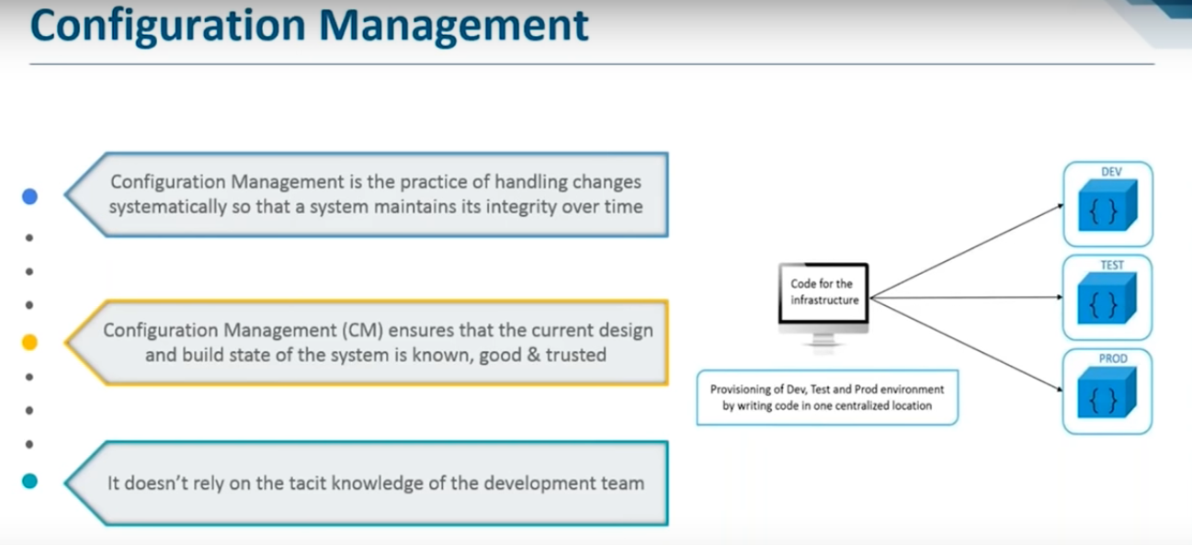
Notes:
Integration of Ansible with Jenkins :
---------------------------------------
Manage Jenkins -- > configure System -- > Publish over SSH -- > Add same like docker machine
In ansible putty as ansadmin :
------------------
cd /opt
sudo mkdir docker
sudo chown -R ansadmin:ansadmin /opt/docker
Run the job from jenkins :
Change . to //opt//docker

Slide 20
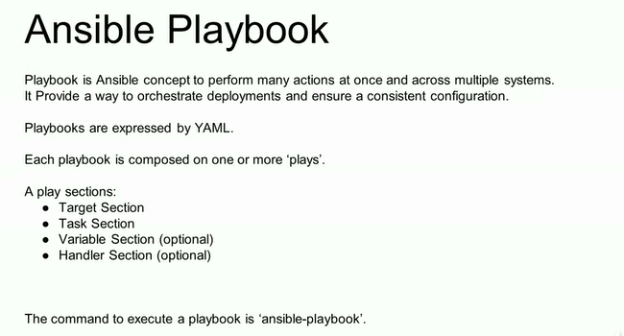
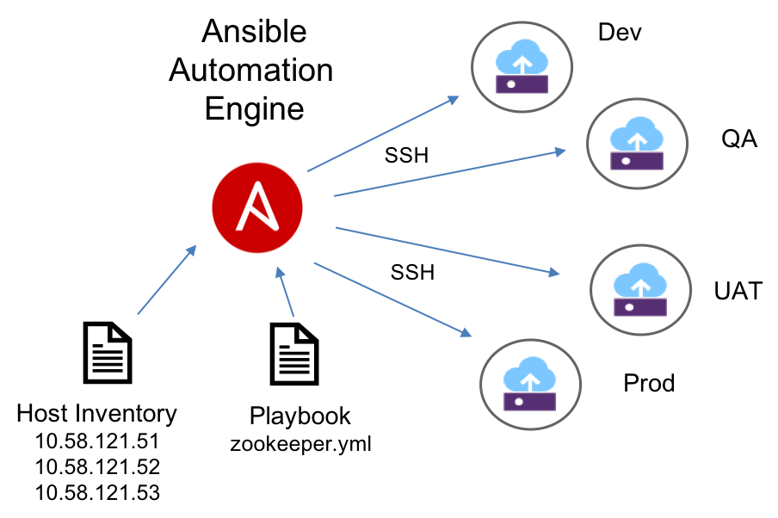
Notes:
https://onlineyamltools.com/validate-yaml

Slide 21
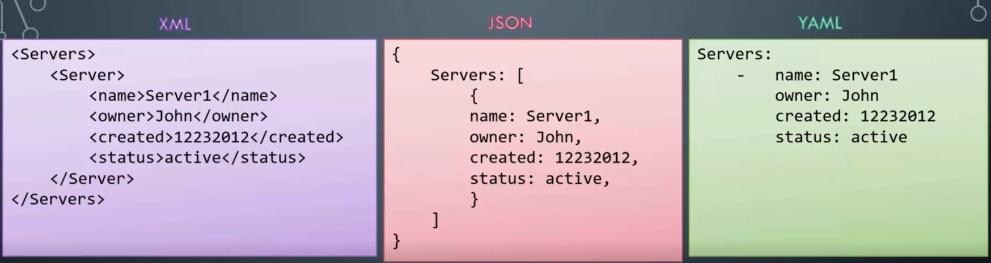
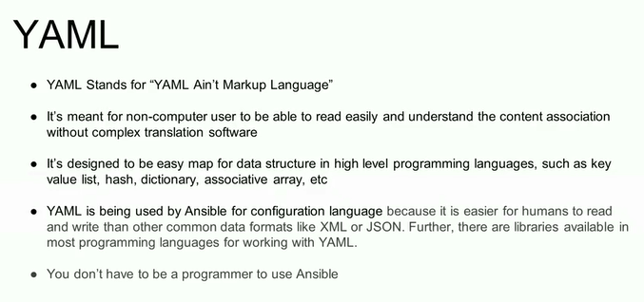
Notes:
sudo ls / and sudo ls /root/ will let you know if the new user added is a sudo user now .
sudo chown –R ansible. /etc/ansible
to check if a software mysql is installed : rpm –qa | grep mysql
If you are not able to push image : use docker login command to connect to hub
If you get missing sudo password error : visudo at home directory add at the end ansadmin ALL=(ALL) NOPASSWD: ALL
Make sure /opt/docker is owned by ansadmin
---
- hosts: all
become: true
tasks:
- name: stop running container
command: docker stop simple-devops-container
ignore_errors: yes
- name: remove stopped container
command: docker rm simple-devops-container
ignore_errors: yes
- name: remove docker image
command: docker rmi simple-devops-image
ignore_errors: yes
- name: building docker image
command: docker build -t simple-devops-image .
args:
chdir: /opt/docker
- name: creating docker image using docker command
command: docker run -d --name simple-devops-container -p 8080:8080 simple-devops-image

Slide 22
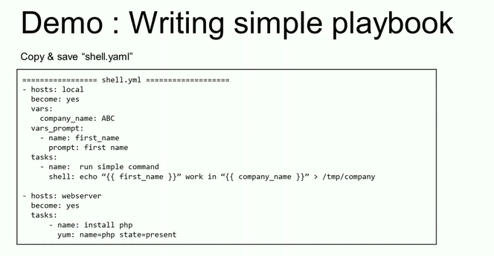
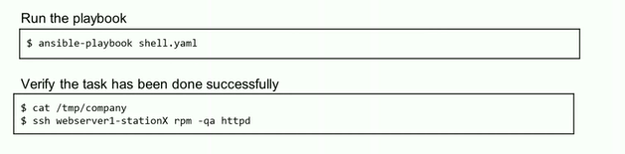
Notes:
Modules are highlighted above
Now in ansible machine as ansadmin @ /opt/docker create :
Dockerfile
# Pull tomcat latest image from dockerhub
From tomcat:8.0.22
# Maintainer
MAINTAINER Vikas
# copy war file on to container
COPY ./webapp.war /usr/local/tomcat/webapps
2. simple-devops-image.yml
---
- hosts: all
become: true
tasks:
- name: building docker image
command: docker build -t simple-devops-image .
args:
chdir: /opt/docker
3. Create a hosts file here also:
vi hosts add local host
ansible-playbook -i hosts simple-devops-image.yml --check
ansible-playbook -i hosts simple-devops-image.yml
4. Add
---
- hosts: all
become: true
tasks:
- name: building docker image
command: docker build -t simple-devops-image .
args:
chdir: /opt/docker
- name: create container using simple-devops-image
command: docker run -d --name simple-devops-container -p 8080:8080 simple-devops-image
check and validate :
Run docker login and service docker start
Make sur that you have added ansadmin ti visudo file .
Make sure /opt/docker directory is owned by ansadmin
Enable sshd_config
Practice

Slide 23
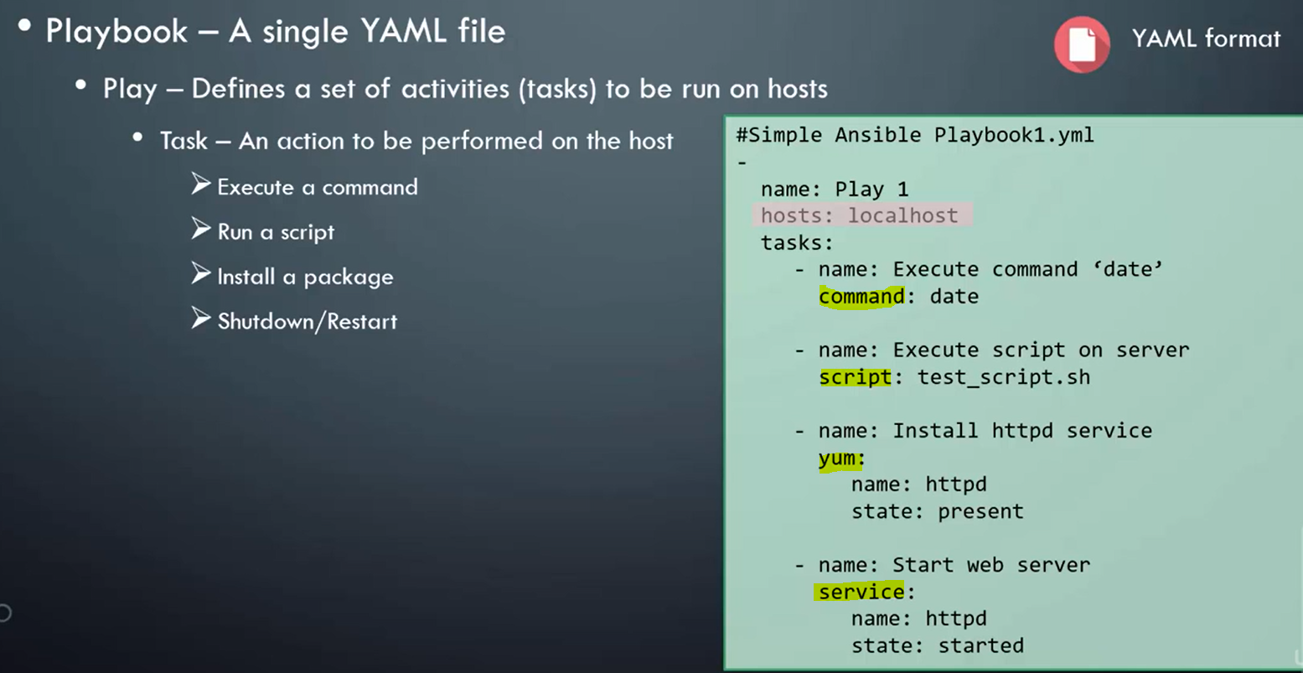
Notes:
Run the same from Jenkins
ansible-playbook -i /opt/docker/hosts /opt/docker/simple-devops-image.yml ;
Create a better ansible playbook simple-dev-ops-project.yml
---
- hosts: all
become: true
tasks:
- name: stop current running container
command: docker stop simple-devops-container
ignore_error: yes
- name: remove the stopped container
command: docker rm simple-devops-container
ignore_error: yes
- name: remove the docker image
command: docker rm simple-devops-image
ignore_error: yes
- name: building docker image
command: docker build -t simple-devops-image .
args:
chdir: /opt/docker
- name: create container using simple-devops-image
command: docker run -d --name simple-devops-container -p 8080:8080 simple-devops-image

Slide 24
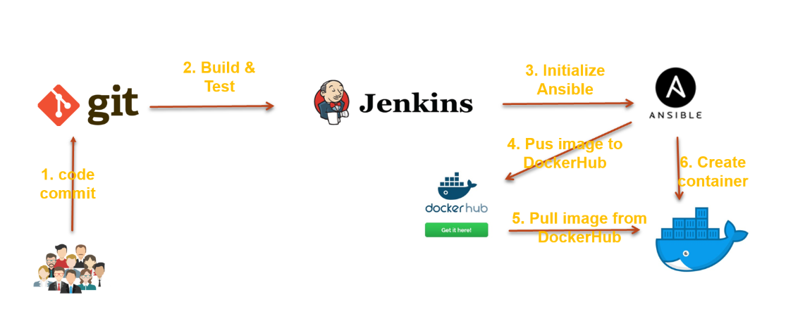
Notes:
docker tag simple-devops-image vikas24775/vikas-cicd-image
docker push vikas24775/vikas-cicd-image
docker pull vikas24775/vikas-cicd-image
vi create-simple-devops-image.yml
---
- hosts: all
become: true
tasks:
- name: create docker image using war file
command: docker build -t simple-devops-image:latest .
args:
chdir: /opt/docker
- name: create tag to image
command: docker tag simple-devops-image vikas24775/vikas-cicd
- name: push image to docker hub
command: docker push vikas24775/vikas-cicd
- name: Remove docker image from ansible server
command: docker rmi simple-devops-image:latest vikas24775/vikas-cicd
ignore_errors: yes
cp simple-devops-project.yml create-simple-devops-project.yml
create-simple-devops-project.yml
======================
---
- hosts: all
become: true
tasks:
- name: stop current running container
command: docker stop simple-devops-container
ignore_errors: yes
- name: remove the stopped container
command: docker rm simple-devops-container
ignore_errors: yes
- name: remove the docker image
command: docker rmi vikas24775/simple-devops-image:latest
ignore_errors: yes
- name: pull docker image
command: docker pull vikas24775/simple-devops-image:latest
- name: create container using simple-devops-image
command: docker run -d --name simple-devops-container -p 8080:8080 vikas24775/simple-devops-image:latest

Slide 25
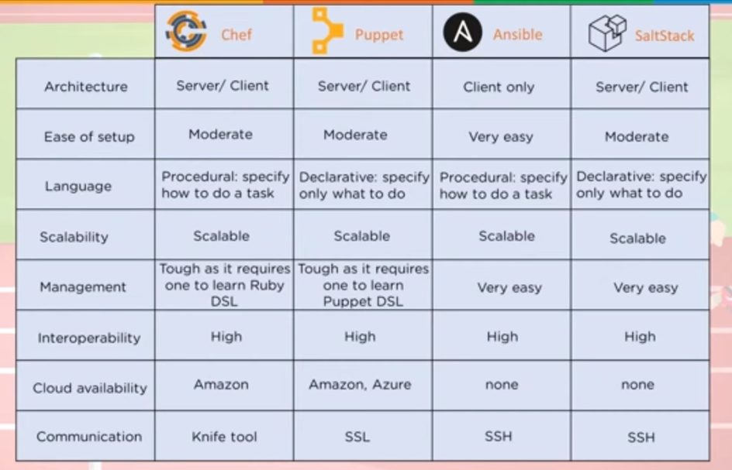

Slide 26
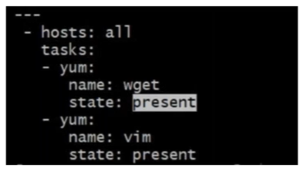
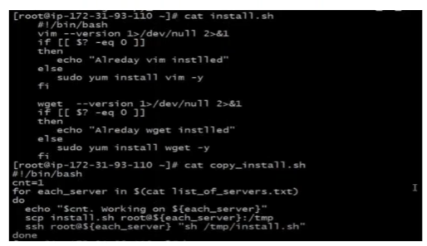

Slide 27
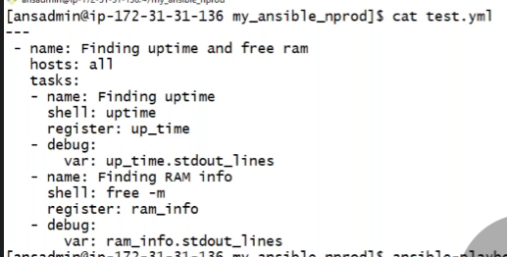

Slide 28

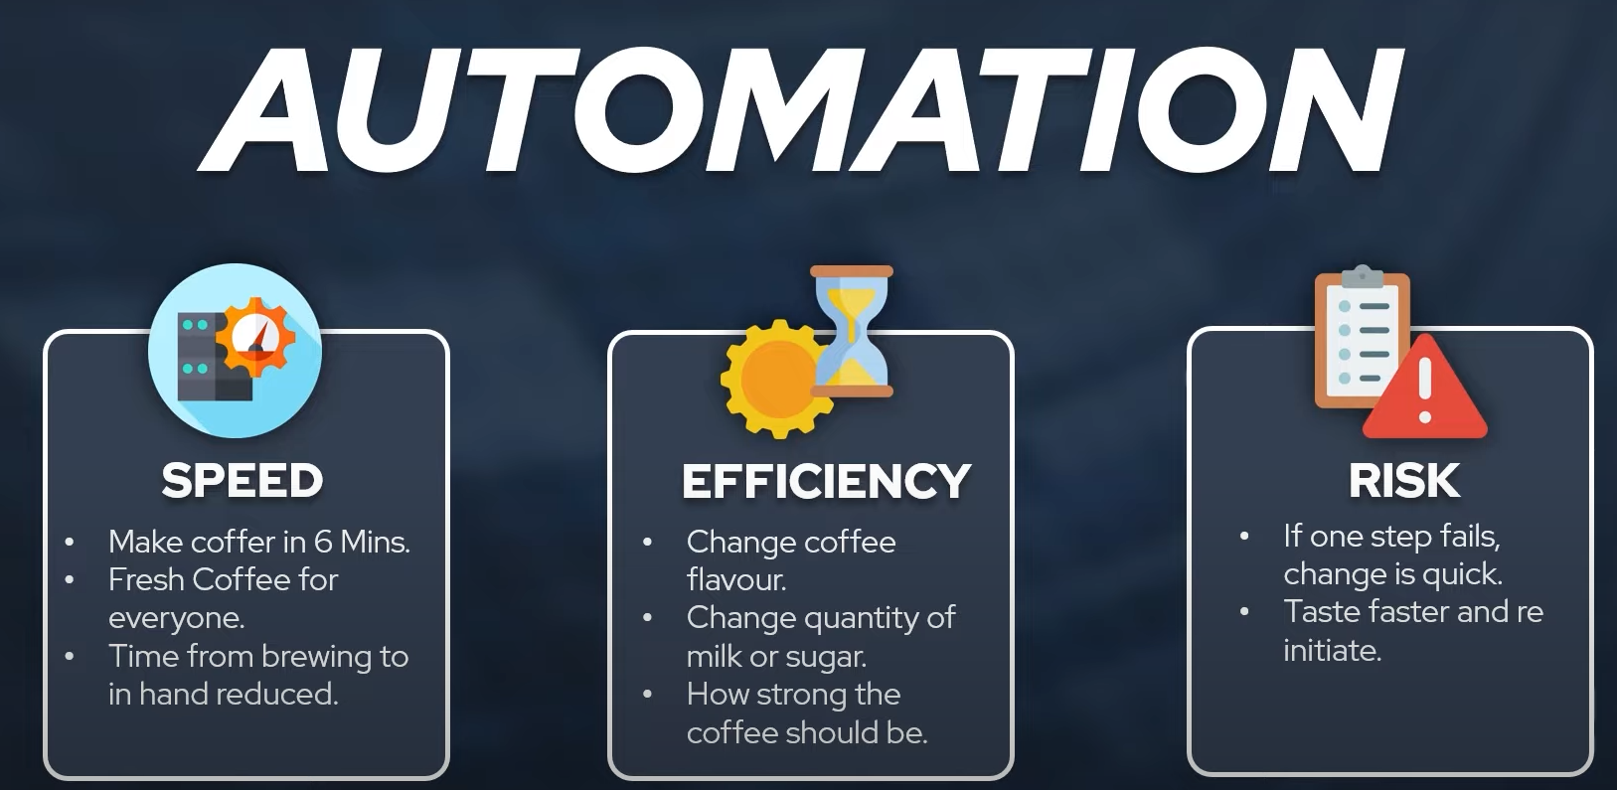




Slide 29
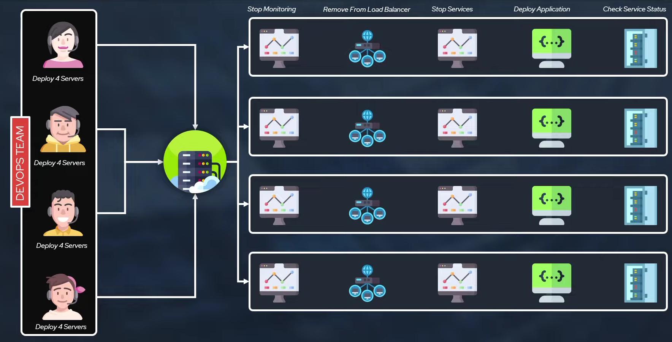
Notes:
Stop Monitoring
Remove instances from Load Balancer
Stop the services running
Deploy Application
Check Service status

Slide 30
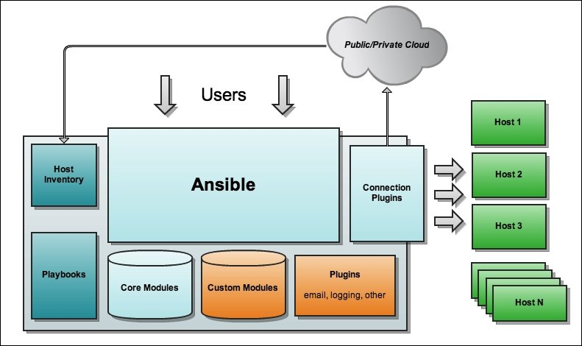
Notes:
If you want to learn things differently and love visualization, then let's jump in
Example: I am managing 100 servers, Like post configuration activity like deployment and patching activity, Like if some SSH vulnerability has hit your application
Now you can log in to each machine you can manually figure out the issue or use automation.
There is a growing demand for automation.
Ansible is a simple IT automation platform that makes your applications and systems easier to deploy. Ansible can help you with configuration management, application deployment & task automation as shown below:
Configuration of servers – Deploy new software
Application deployment
Continuous testing of an already installed application
Provisioning
Orchestration
Automation of tasks
Limitation :
Can’t perform initial software like OS.
Doesn't track the drift or changes made

Slide 31
Notes:
edit hosts file for specific requirement
[Webserver]
client1:8080 ansible_connection=ssh ansible_user=vikas
[ip-range]
172.168.2.[0:20]
[multi-server]
sever[01:10].example.com
ansible --list-hosts multi-server
Make password compulsory :
On client Machine : visudo -- > ansadmin ALL=(ALL) PASSWD: ALL -- >
Now on ansible controller machine – ansible -m command -a “vgs” webserver --become -K
Ansible configuration:
/etc/ansible/ansible.cfg
#become=True
#become_method=sudo
#become_user=root
#become_ask_pass=True

Slide 32
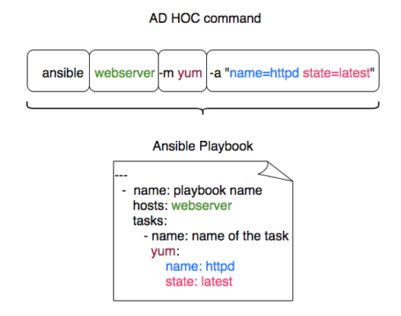
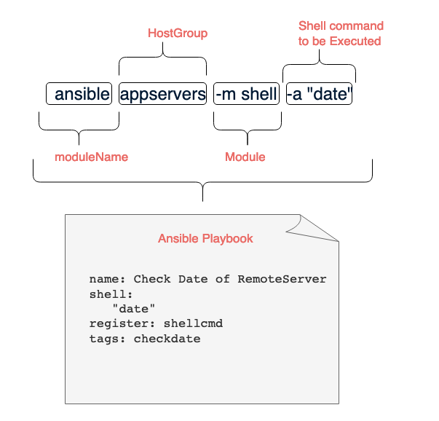
Notes:
ansible --list-hosts <webserver>
ansible --list-hosts all
ansible -m command -a “uptime” webserver
ansible -m ping webserver
touch file1
ansible -m copy -a “src=/etc/file1 dest=/tmp/file1” webserver
ansible -m file -a “dest=/tmp/abc mode=777 owner=ansadmin group=admin” webserver
ansible -m file -a “dest=/tmp/abc state=absent” --become -K webserver
ansible -m yum -a “name=httpd state=present” --become -K webserver
ansible -m service -a “name=httpd state=started” --become -K webserver
ansible -m service -a “name=httpd enabled=yes state=started ” --become -K webserver
ansible-playbook --syntax-check <yaml file>
ansible-playbook --step <palybook.yml> -C
ansible localhost -m command -a set
ansible localhost -m shell -a set

Slide 33
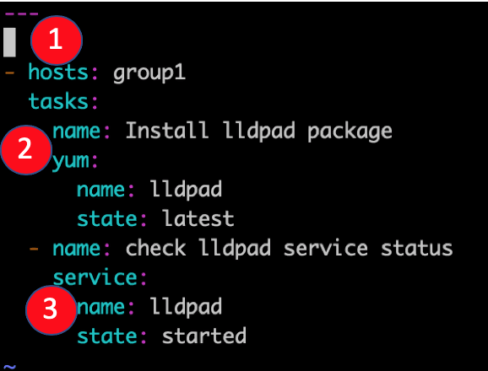
Notes:
Playbooks are the files where Ansible code is written. Playbooks are written in YAML format. Playbooks are one of the core features of Ansible and tell Ansible what to execute.
Ansible uses YAML syntax for expressing Ansible playbooks because it is very easy for humans to understand, read and write than other common data formats like XML or JSON.
Each playbook is an aggregation of one or more plays in it. Playbooks are structured using plays. There can be more than one play inside a playbook.
===============================================================
---
- hosts: dev
become: true
become_user: root
tasks:
- name: run the script
script: /home/sverma/ansible/scr.sh
when: ansible_distribution == "RedHat" and ansible_distribution_major_version == '7’
===============================================================

Slide 34
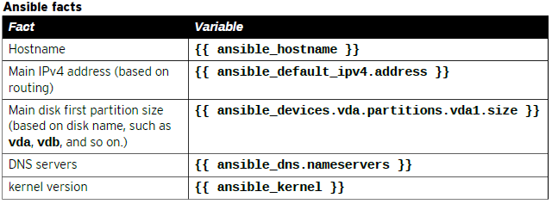
Notes:
Ansible facts are variables that are automatically discovered by Ansible from a managed host.
ansible <web-server> -m setup -a “filter=hostname”

Slide 35
Notes:
Ansible Inventory file can be declared as:
web01 ansible_host=<pvt-ip> ansible_user=ec2-user ansible_ssh_private_key_file=<key-pair path>
db01 ansible_host=<pvt-ip> ansible_user=ec2-user ansible_ssh_private_key_file=<key-pair path>
[webserver]
web01
[db-server]
db01
[dc_Mumbai:children]
webserver
db01
[webserver:vars]
ansible_user=ec2-user
ansible_ssh_private_key_file=<key-pair path>

